Slide 1

.
.

Slide 2

Different scenarios
We might face

Slide 3

VALIDATING
Victim approaching to the police
After approaching to the police. Poice need to check the information delivered my the victim after the occurance of incident will be analysed and looked out thoroughly for deciding whether it is valid or not.

Slide 4

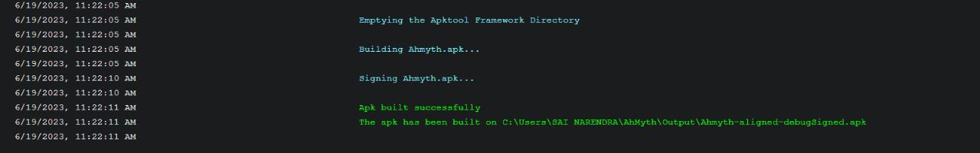
Generating APK file
We have to build the APK file into the victim machine inorder to that we first enable the associate features like camera,mic,call logs etc., and we will bind.

Slide 5

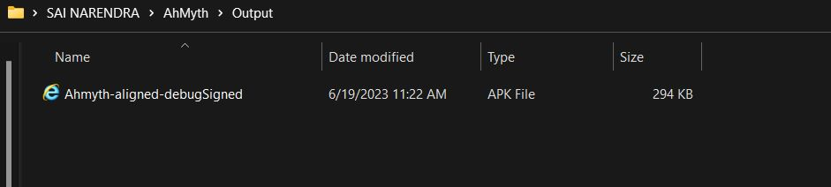
INJECTING APK FILE
After creating it. The apk file will be generated in the path that showed in the previous slide.
With the help of the path we will install apk file into victim device to get access from that device.

Slide 6
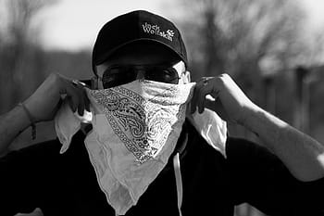
TRAITOR - POLICE
Chance that police may be combined in the crime.
If so then the accessing of the device that may lead to another consequences.
→ For that we have to clear the RAM and enable the security features in the device.

Slide 7

DIFFERENCE OF OTHER VERSUS THIS AHYMTH
Evidences - By enabling Camera option we can see what the actual situation is.
Rescue Faster - Location tracking
Recording - We can save the conversation by recording.

Slide 8

.

